Slide 1
ITP Information session
Basic information & formats
15 Dec 2022

Slide 2
Agenda
13:00 – 13:10 | Opening of session and intro Koen De Koster, Strategy and Operations Manager
13:10 – 13:30 | Demonstration of online submission tool & formats to be uploaded (incl. Q&A) Michaëla Stubbers, Head of Digital Factory
13:30 – 13:55 | Introduction - ITP 2023 call basics and introduction to the formats Geraldine Mabbe, Global Partnerships Manager (General Policy ITP)
13:55 – 14:15 | Q&A
14:15 – 14:45 | Financial guidelines & format for project proposal writing Ise De Smet, Mobility and Scholarships Coordinator (ITP & Scholarship policy) Mathieu Lanin, Financial advisor
14:45 – 15:00 | Q&A and closing

Slide 3

ITP - Aim
ITP projects are:
- short- to medium-term,
- intensive, interactive
-practice-oriented training courses
ITP projects systematically integrate global perspectives to create a supportive, inclusive, and networked learning environment in which professionals acquire transversal skills and state-of-the-art knowledge on sustainable development. This enables them to become experts and critical global citizens who are motivated to act as change agents in their network.

Slide 4
1. Introduction

Slide 5







VLIR-UOS seeks to empower institutions and individuals as critical drivers as well as agents of change through higher education scholarships and partnerships for sustainable development looking for innovative responses to global and local challenges

Slide 6

Key features of ITP
Focus on capacity building of professionals through short-term training
  Trainees becoming agents of change
  Their professional context as driver of change
Max. duration of 3 years, including training modules for a max. of 6 months
Organised in (i) Flanders, (ii) partner countries, or (iii) mixed - hybrid (online or blended)
Flexibility: preparatory and follow-up activities
Several editions, min. 8 scholars for each edition
Two types:
  Academic training programmes
  Transversal organisational capacity building
Max. budget per ITP: 150.000€
Notes:
ITPs have become projects, which means they now follow a project logic with a focus on capacity building by funding short-term training. Now, activities in preparation of, during and in the follow-up of the training can be funded as well.
There is no fixed format anymore as to where and how to organise the training: ITPs can either be organised at a Flemish higher education institution, or in one of the 17 partner countries. Either online, in person, or a hybrid format.
Several editions of a training can be implemented during a project implementation period of maximum 3 years, benefitting at least 8 scholars.
The ITP project logic accommodates a maximum requestable budget of EUR 150,000, combining the training and scholars’ costs.
Agents of change stimulating their professional organisations to become drivers of change •Well defined strategies towards selection of trainees,including multi-stakeholder partnerships (rather than open
Academic training programmes, dealing with topics related to sustainable development challenges, Agenda 2030, transversal or priority themes. Directed towards professionals from civil society, private, or public sector.
Transversal organisational capacity building training programmes, oriented towards professionals of HEIs (digitisation in higher education, change management, scientific writing, QA, how to set up an international relations office, tech transfer, etc.)

Slide 7
Who can apply?
Flemish promoter: employed as a professor (in principle min. 10% ZAP) at a Flemish university; or a professor/lecturer at a Flemish university of applied sciences and arts.
Partner promoter (if any): employed at a recognised higher education institution or national public (not for profit) research institute located in a VLIR-UOS project partner country.
Additional criteria
Only 1 project proposal per applicant (Flemish/partner) can be submitted.
Promoters of an ITP 2022 project cannot submit any new ITP project.
Promoters of an ITP 2022 project proposal that was not selected, can resubmit their proposal, however, on the condition that follow-up was given to the assessment of the commission.
At the level of the partner institutions, no further criteria apply. Former and present IUC partner institutions are fully eligible, without any restrictio
Notes:
VLIR-UOS will discuss the eligibility criteria and internal regulations as to project promotership of the respective Flemish HEIs on 16/12/2022 and at VLIR-UOS level, and will provide further clarity as to the eligibility criteria on the VLIR-UOS website shortly after 16/12/2022.

Slide 8
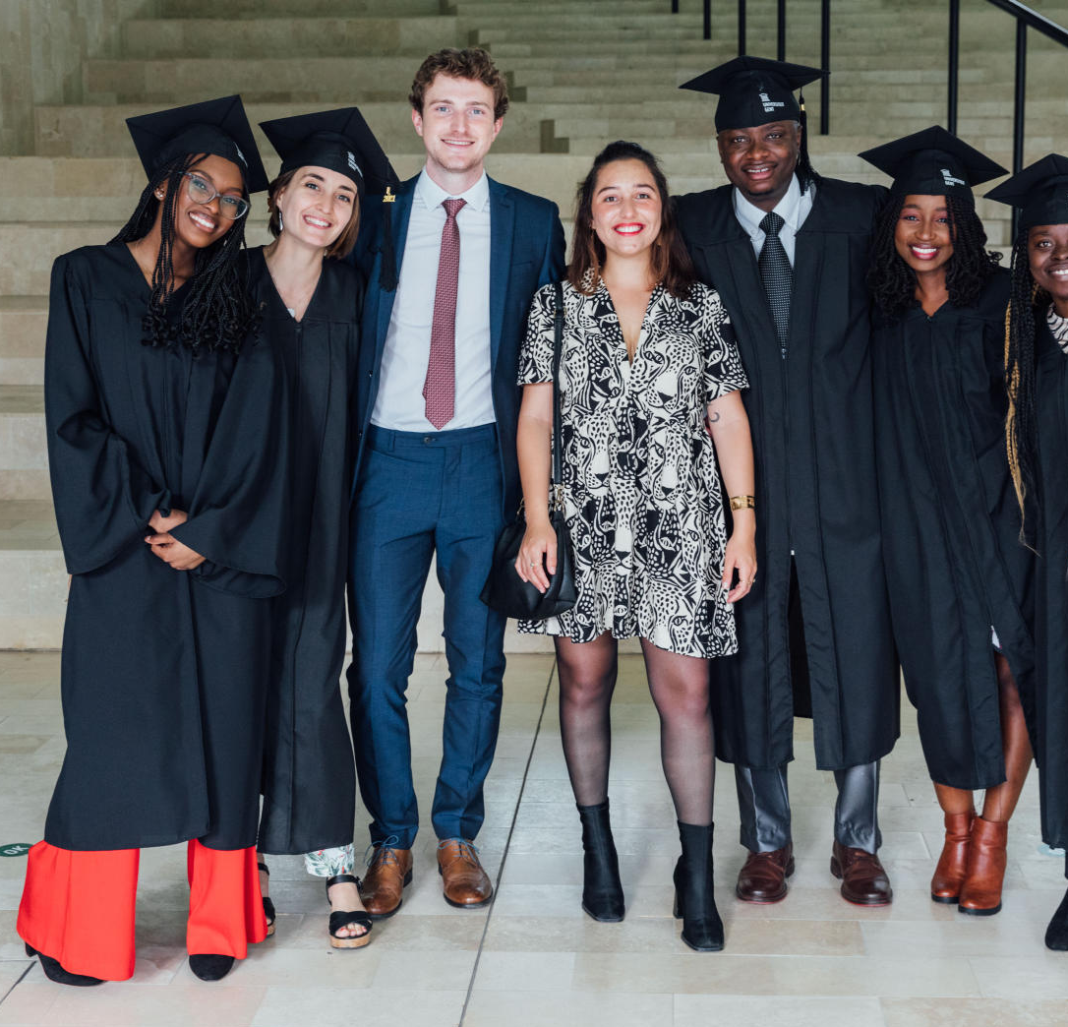
Target groups
Define target groups
Define recruitment strategy
Define selection procedure
Notes:
The precise target group(s) (and criteria) aimed at by the applying promoter needs to be specified in the application, together with preliminary information on the possible participants and a description of the recruitment strategies that will be used
The ITP project is responsible for the organisation of the application and selection of the participants and of the scholarship candidates by defining a selection procedure
recruitment policy (e.g. focus on specific region or country or specific background (LNOB)). Please describe and justify this approach. Indicate how you will reach participants from the VLIR-UOS scholarship list, and how you will target both male and female participants in a 60/40 ratio.
selection criteria that candidate-participants Examples of possible criteria: Academic level (master, PhD, etc.), Domain(s) of previous education, Professional expertise, etc. Describe the procedure (incl. selection commission) to select (scholarship) candidates.

Slide 9

Points of attention
Target groups: professionals
A 40-60% balance between male and female
No age limitations for participants
Reasonable cross-section of trainees from different countries and regions
Attention for vulnerable groups
‘Leave no one behind’ principle, we want to give as many new applicants as possible a chance to receive a scholarship
Notes:
The target group of ITP are professionals from civil society, private or public sector and/or academics, scientists, researchers at HEI with relevant professional experience in the subject of the organised ITP

Slide 10
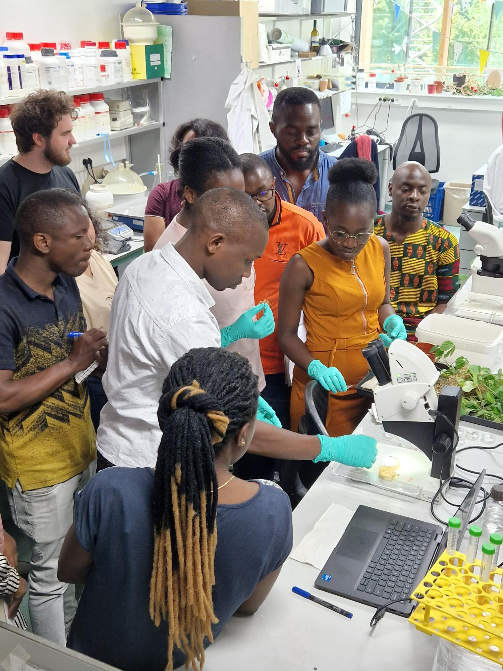
Eligibility of countries
17 project partner countries:
Africa: Benin, Burundi, DR Congo, Ethiopia, Kenya, Morocco, Rwanda, South Africa, Tanzania, Uganda
Latin America: Bolivia, Cuba, Ecuador, Peru
Asia: Indonesia, Philippines, Vietnam
+
Belgium
Notes:
Small expenses for activities in non-VLIR-UOS partner countries (e.g. a field trip) can be allowed if these remain limited and fit the finality of the ITP project.

Slide 11
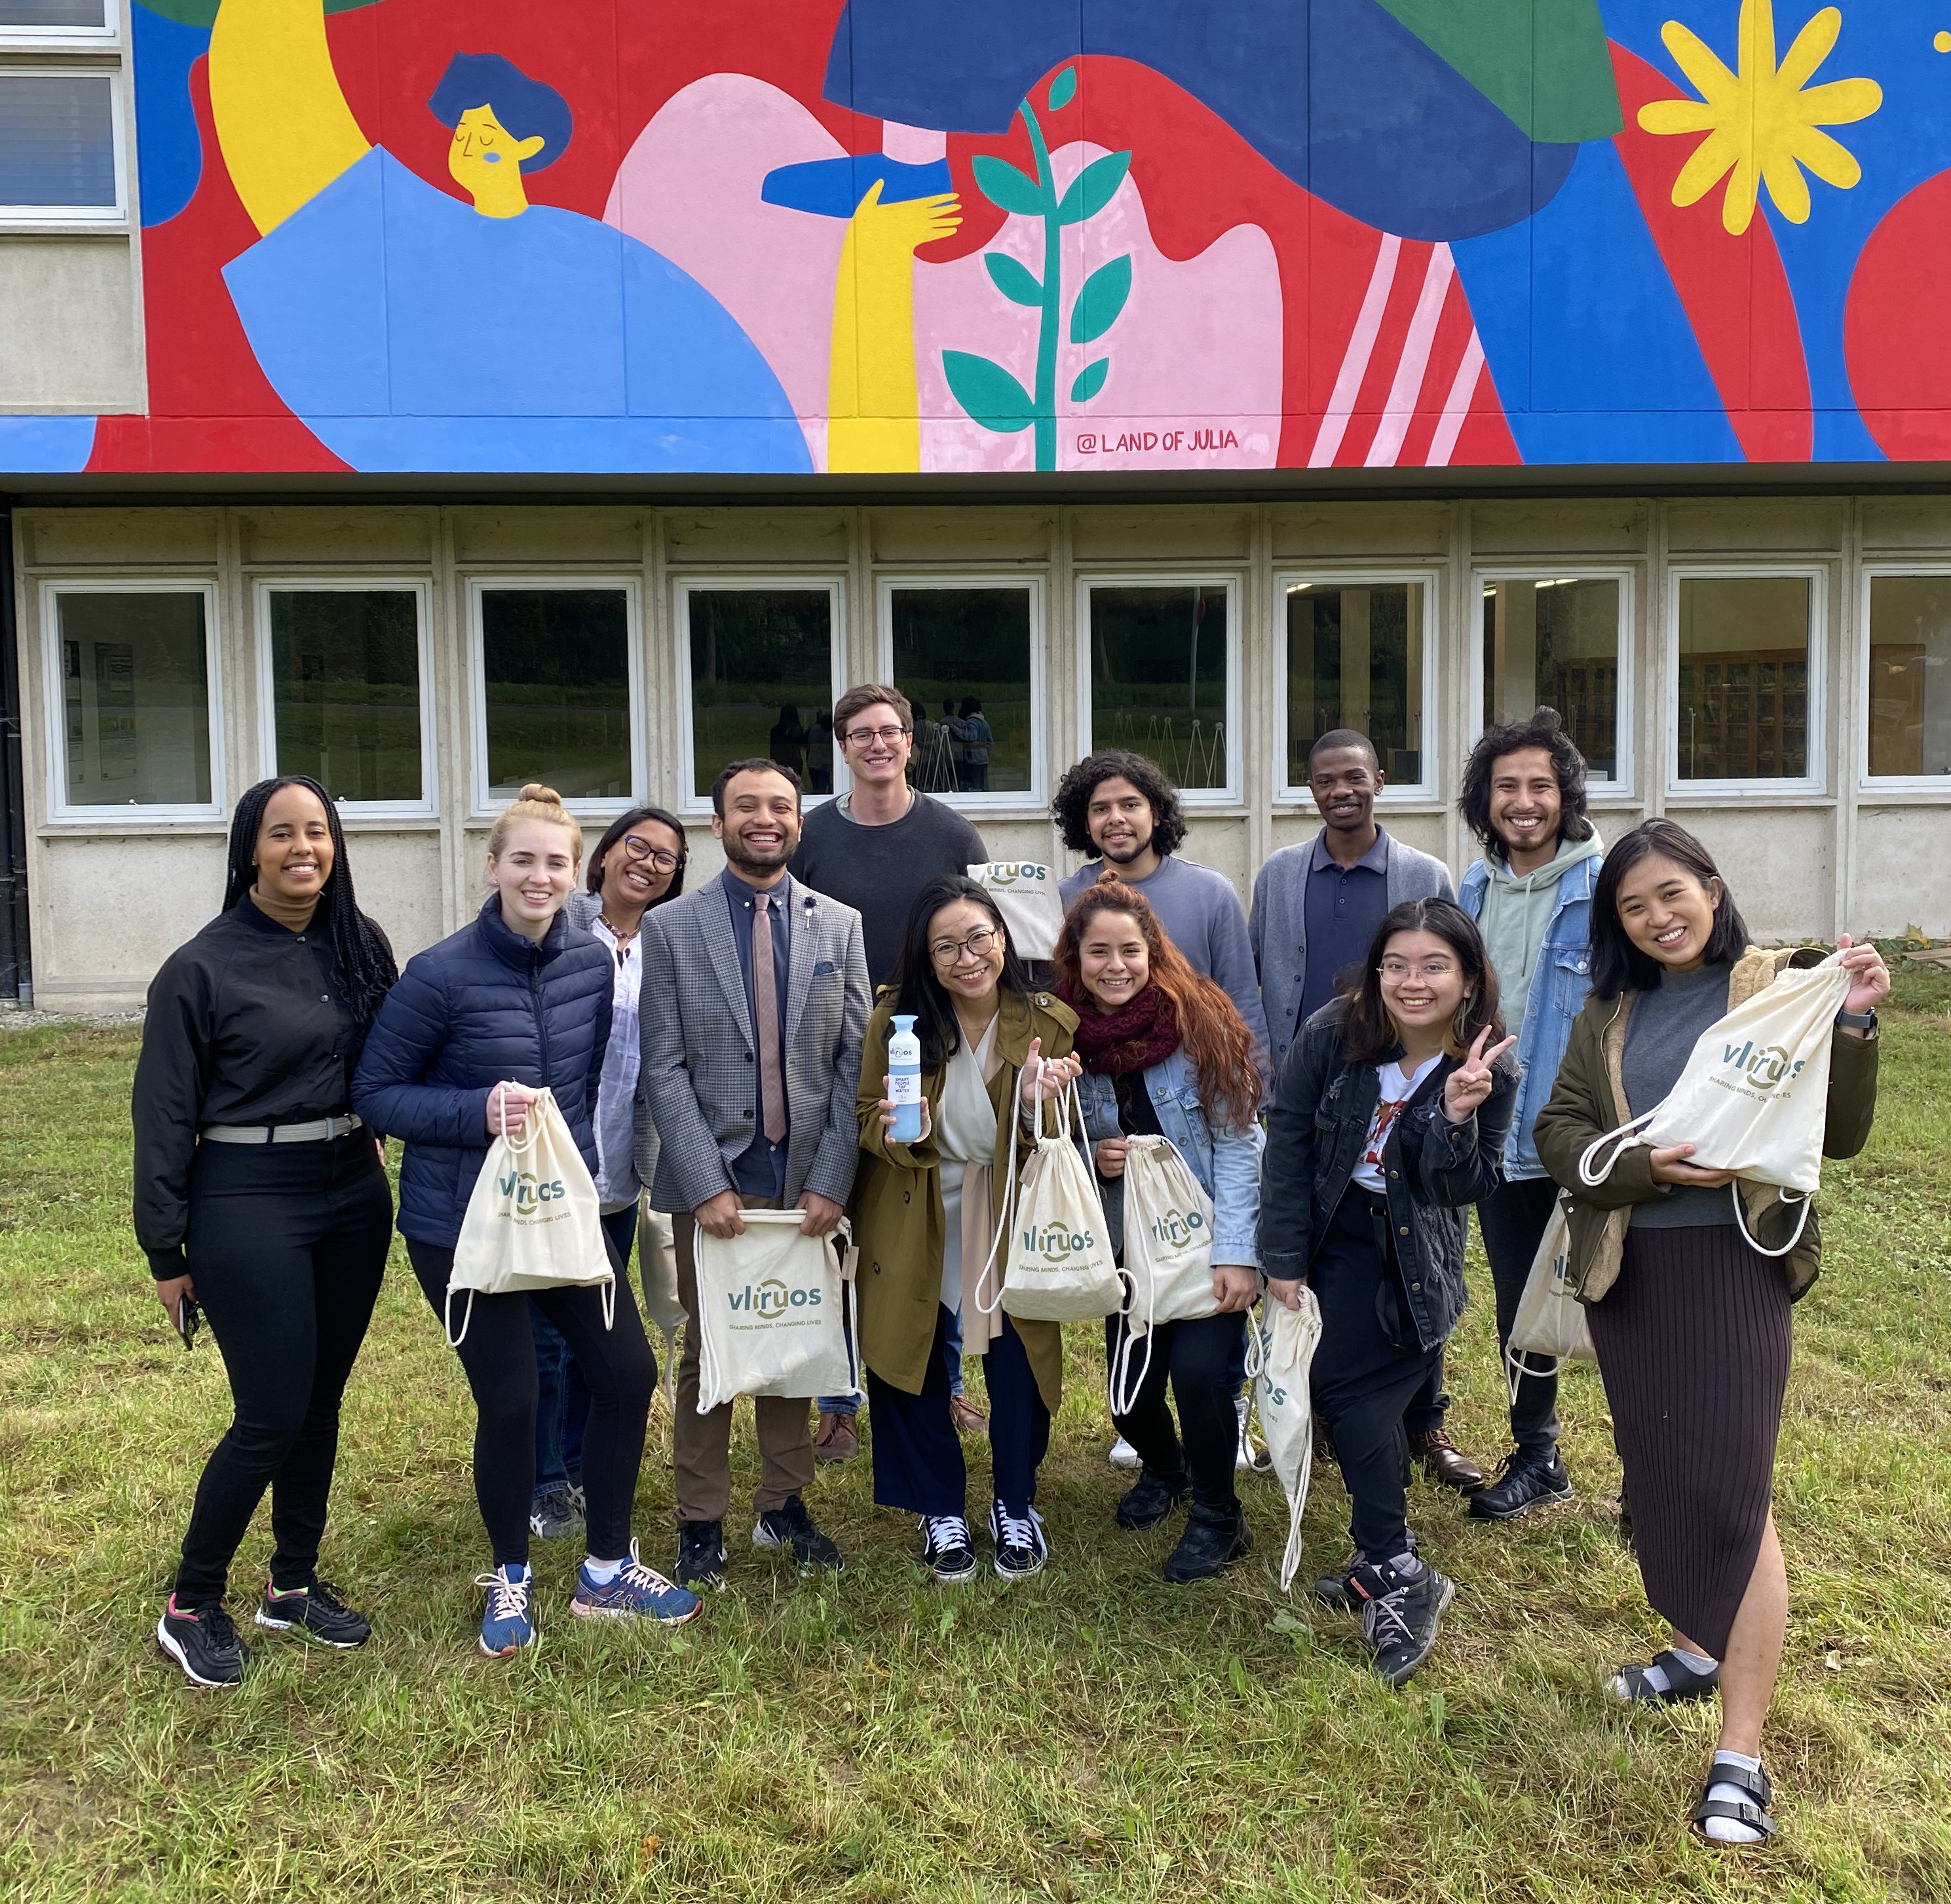
Eligibility of scholars
Scholarship candidates have to be a national and resident of one of the 29 VLIR-UOS scholarship countries.
OR an employee of a target organisation (HEI, NGO, SME, …) in one of the 17 VLIR-UOS partner countries (candidates exceptionally can have a different nationality, but this should be a minority)

Slide 12
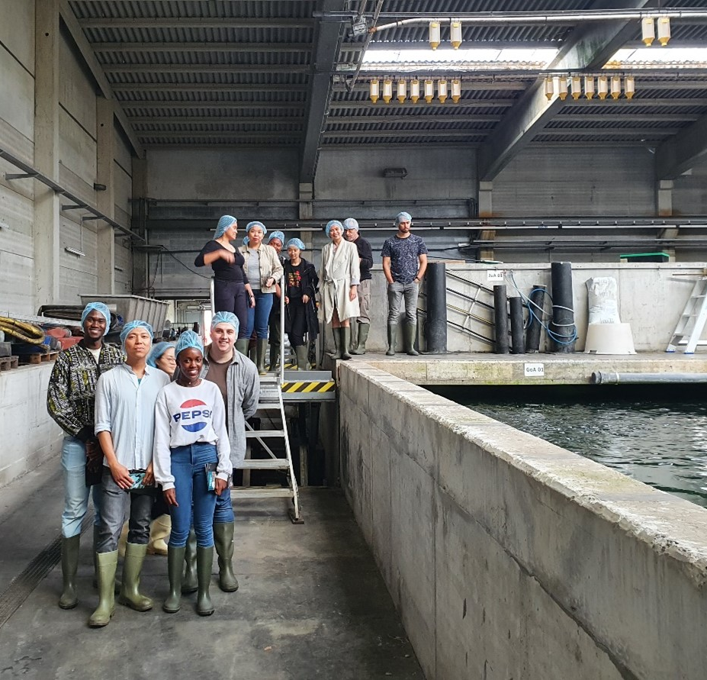
How to submit a proposal?
Project applications are submitted through an online platform
An application involves a Flemish and possibly one or more partner promoter
It is the Flemish promoter who submits to the ICOS of the Flemish university (association) for support and quality control.
  Flemish promoters should check internal deadlines at level of the Flemish institution
  Role GEO at level of Univ. of Applied Sciences and Arts defined per university association
The ICOS will validate so that the proposal can be submitted to VLIR-UOS.

Slide 13
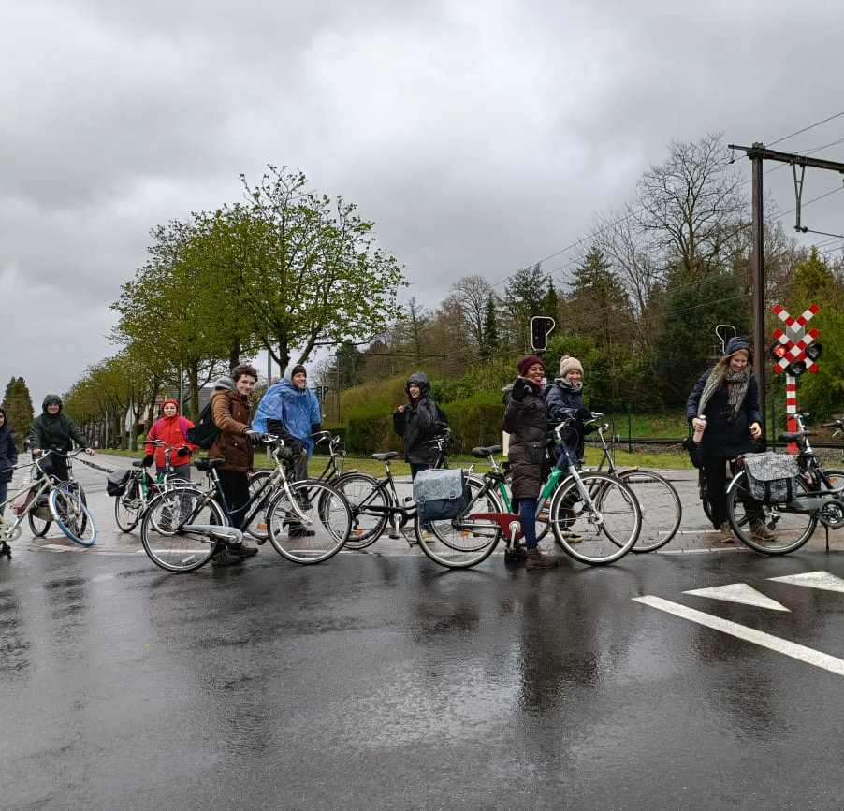
Selection procedure
4 standard selection criteria:
  Relevance and coherence of the project;
  Quality of the project design;
  Implementation set-up of the project;
  Potential impact and sustainability.
ICP&ITP Selection Commission consists of 4 independent experts
ITP 2023: 9 selectable projects
Notes:
Relevance: The extent to which the proposal responds to beneficiaries’, global, country, and partner/institution’s needs and policies
Coherence: fits within the programme Theory of Change (ToC) and within the institution/context
2. Quality: a convincing project strategy, eg. a realistic and applicable Theory of Change (ToC) narrative, elaborates an appropriate and feasible (scientific, academic or pedagogical) methodology
3. Implementation set-up: a strong plan and partnership for the execution of the project e.g. clear planning, cost-effective, …
4. Potential impact and sustainability

Slide 14
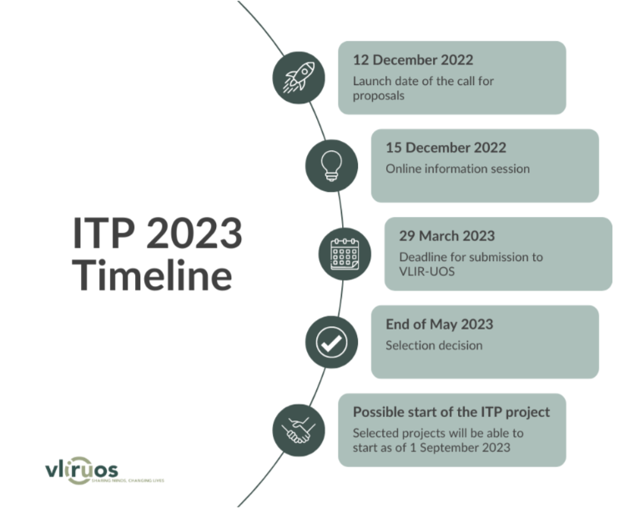
Timeline

Slide 15
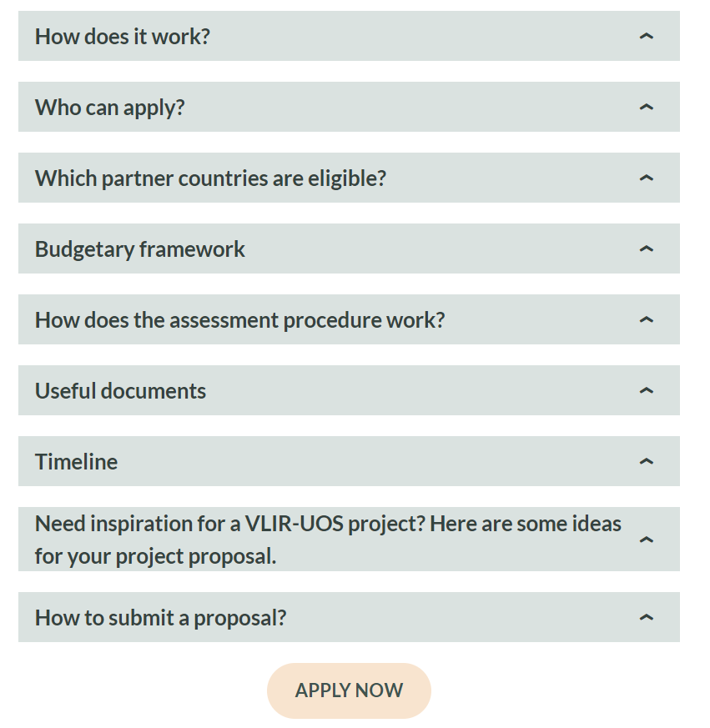
Resources
Website: Call ITP 2023
Call ITP 2023 document as entry point
How?
  Formats = working documents (Call Annexes)
  Project applications are submitted through an online platform

Slide 16
2. Formats and guidelines

Slide 17

ToC aligned with Agenda 2030
Align your proposal on the VLIR-UOS TOC
  Standardized impact areas (3),
  outcomes (6)
  intermediate change domains (6)
Ambition to Connect 4 change
Coherence and complementarity
  Country reference frameworks
  Thematic strategic framework on HE4SD
  Inter-institutional collaboration (between HEI)
SDG Principles as a starting point to integrate transversal & priority themes

Slide 18
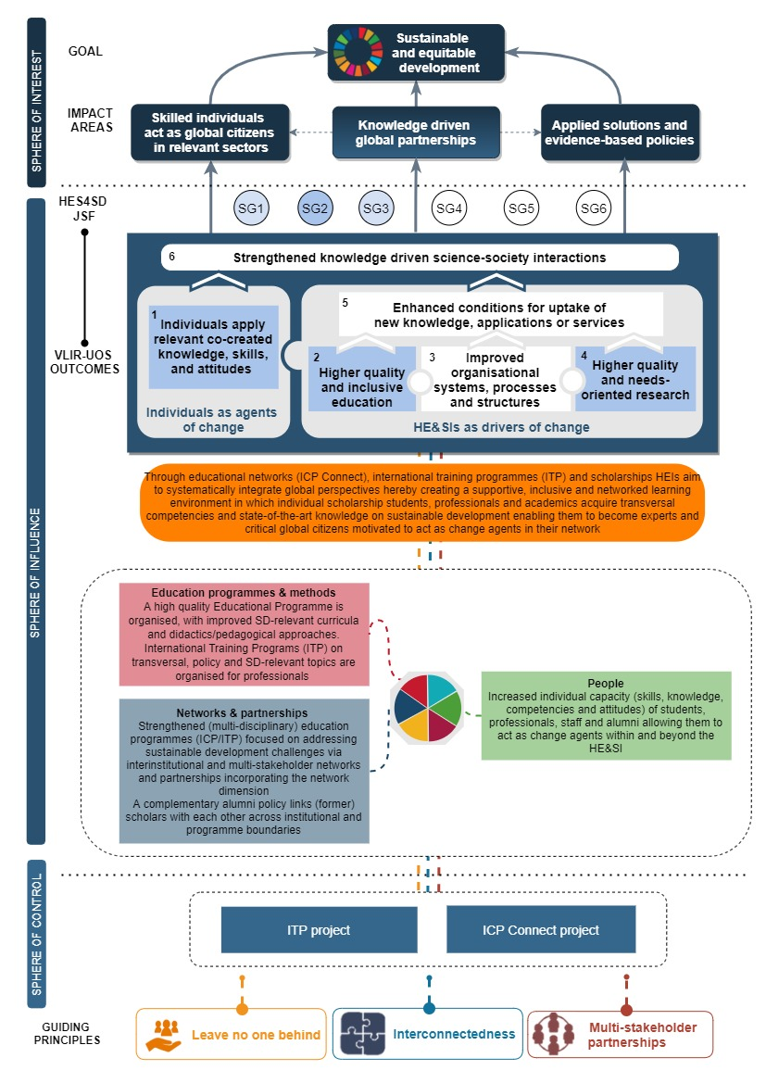
VLIR-UOS
Theory of Change
1 goal
3 impact areas
6 VLIR-UOS outcomes
along 2 axes:
Individuals as agents of change
HEIs as driver of change
6 intermediate change domains
Notes:
The SDG principles serve as a compass in VLIR-UOS endeavour of sharing minds, changing lives. As visualised in the ToC, they are transversally integrated to render the activities and change processes SDG-proof.
VLIR-UOS considers global engagement for higher education as a goal (SDG 4: Quality Education) and a means for attaining other SDGs through knowledge co-creation, transfer and valorisation. In the long run, ICP is expected to contribute to more sustainable and equitable development due to its potential to foster:
Application of solutions and evidence-based policies
A global community of skilled individuals who act as global citizens in relevant sectors
Knowledge-driven global partnerships
The first impact area relates to the role of higher education in contributing to innovation and the valorisation and application of new knowledge, insights and evidence for sustainable development.
The second impact area aligns with the evidence provided in the UN Global Sustainability report 2019, which highlights the potential of HEIs to develop through their teaching generations of new leaders and skilled professionals for sustainable development.
The third impact area draws upon the idea that reciprocal partnerships are essential in safeguarding knowledge co-creation, exchange and uptake within and beyond the scope of the supported interventions. This final impact area also matches the ITP concept, as ITP projects enable the development/strengthening of networks of professionals in various sectors, academia, etc. thereby unleashing the full potential of partnerships.
Thus besides the above, individual projects may choose to focus on a sub-selection depending on priorities and needs of local stakeholders. Yet, projects are required to document their choices through their project-specific Theory of Change to ensure alignment with the programme’s vision towards change.
VLIR-UOS outcomes (1) Individuals apply relevant co-created knowledge, skills, and attitudes, (2) HEIs provide higher quality and more inclusive education and (4) HEIs conduct higher quality and needs-oriented research.
An ITP project can focus on different project domains (=domains of intermediate change) that contribute to the different outcomes, with ‘Education programme and methods’, ‘People’ and ‘Networks and partnerships’ being the main ones. It is possible that ITP projects focus on one or more of the other project domains (outreach and policy support; research programmes and methods; systems, policies and infrastructure) and if this is the case, promoters are invited to clarify their focus on one of these additional domains. The most important changes, resulting from ITP projects and examples of deliverables for these three domains, are outlined in the table below. It presents a non-exhaustive and indicative list of deliverables and activities that individual projects can undertake. The deliverables, processes and changes in these domains are interlinked and not mutually exclusive.
People: Students, alumni, staff, researchers are trained/sensitised in a supportive learning environment to strengthen their knowledge, skills & attitudes in diverse domains (e.g. leadership, global citizenship).
Education programmes and methods: Improved, innovative and inclusive teaching methods, didactics, and digital approaches. Improved curriculum content to support knowledge co-creation and equip students with the necessary skills and knowledge ensuring their career development after the training and ability to tackle global challenges from a holistic and interdisciplinary perspective.
Networks and partnerships: Strengthened interactions within reciprocal partnerships and engagements at local, regional and global levels between HE&SIs, researchers, staff, students and other stakeholders in society (public actors, private actors, other CSOs, communities, etc.) for sustainable development

Slide 19
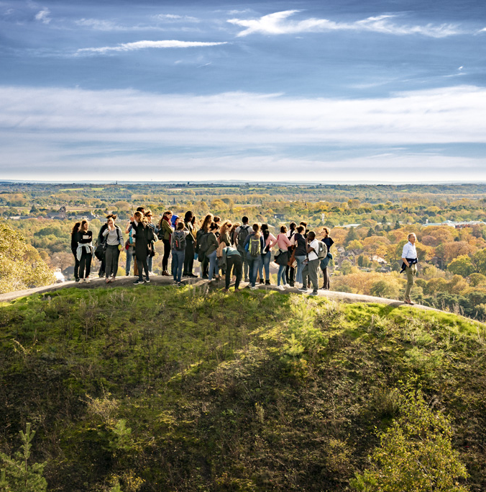
SDG principles as entry point
Leave No One Behind (LNOB)
to end extreme poverty in all its dimensions … to curb horizontal and vertical inequalities and to take action to reach the furthest behind first
Targeted approaches: types of countries & institutions, LNOB fund, etc.
Mainstreaming in all interventions
Notes:
Link with HRBA
Balancing academic excellence and LNOB
Mainstreaming
Adding mechanisms to existing instruments (LNOB fund, diversification in scholarship amounts, etc. )
Asking all projects to reflect on LNOB, specifically around gender, diversity & inclusion → bottom-up → what does it mean for them?
… starting to measure, better socio-economic profiling of scholarship holders

Slide 20

SDG principles
    Indivisibility & Interconnectedness
    Interaction between Goals & targets
    Co-benefits … or trade-offs
    Importance of holistic context analyses & systems thinking
    Specific attention for: Gender equality, inclusion and diversity / Environmental Sustainability
Notes:
+ hinting at importance of transdisciplinary work

Slide 21
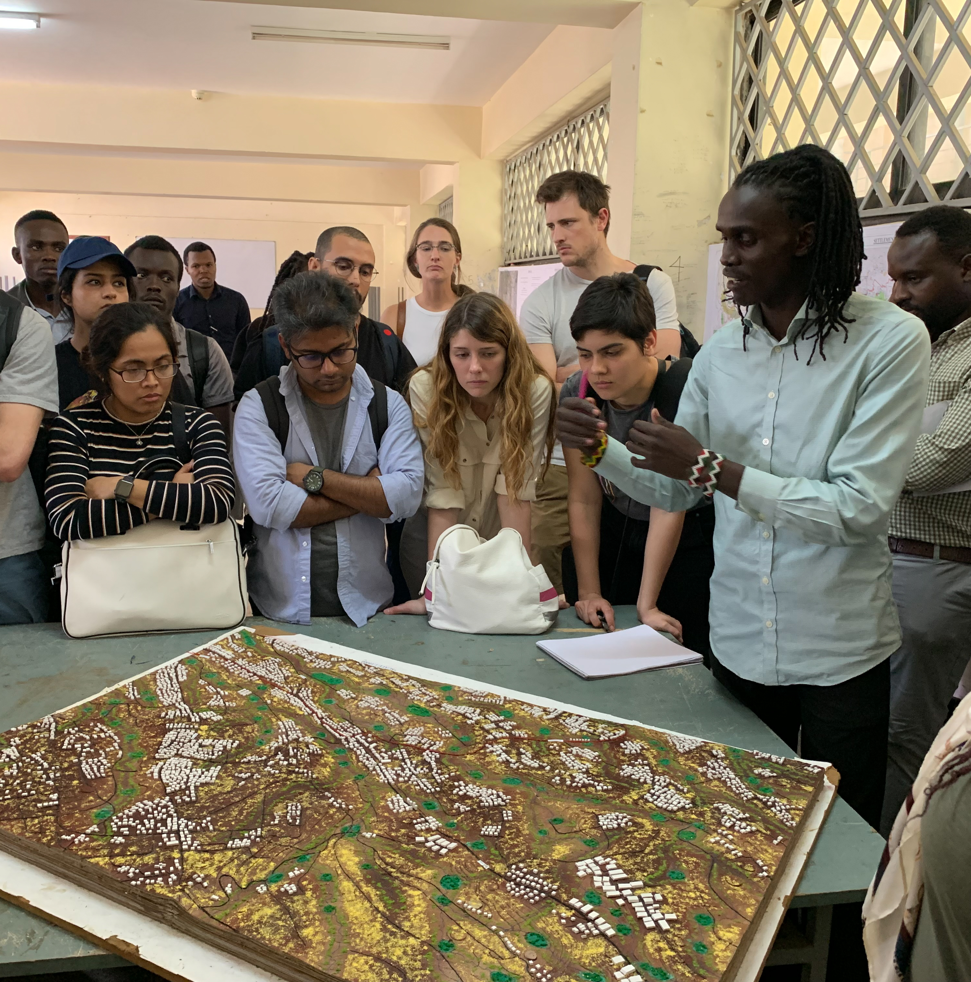
SDG principles
    Multistakeholder partnerships
    Complexity, scale, and interconnectedness of the challenges … requires a concerted effort of a wide variety of different stakeholders.
    In all calls focus on
    Assuring coherence
    Interinstitutional collaboration (pooling expertise)
    Multi-stakeholder partnerships (across sectors)
    (Financial) incentives
    Organise matchmaking

Slide 22

Support & guidance offered
These powerpoint guidelines for the formulation of an ITP
Formats (working doc, you need to fill out the modules in the online project submission tool to access):
  Word template as a working document and outline for online submission of information via the online tool
  Excel template for Module 3 (organisation) and 5 (activities)
Support videos will become available on the website
Available in case you want to read more: Theory of change and methodological guide (support document) with background information, tips and tools & checklist for integrating SDG principles per module
Notes:
Link tot tool toevoegen – link toevoegen DOC

Slide 23
Available resources
Support videos: VLIR-UOS theory of change , …
Methodological background document: info on theory of change concepts / integration of SDG principles
Information per country – country reference frameworks
  Call document: links per country included, or on Country page website
  Link SDG voluntary review per country / Agenda 2030/overview ongoing projects per country / others actors present in country
Ideas for cooperation: requests for cooperation from other actors (per country/theme)
Selection system document and Gender policy document

Slide 24
Content: 8 modules
1: Context / problem analysis
2: Project strategy (Impact statement and ToC)
3: Organisation
4: Stakeholders and coherence
5: Planning & budgeting
6: Risk management
7: Monitoring
8: Learning and steering
Notes:
AAN TE PASSEN

Slide 25

Module 1
Context analysis
1. Sustainable development context
2. Individual and organisational capacity building context
ESSENCE
Develop a broad – and shared – understanding of the system in which the desired change is needed. The context analysis justifies the importance / relevance of the project, delimits the scope and contextualizes the reasons why the project is needed (i.e. interconnected problems being faced).

Slide 26

Module 1
Sustainable development context
Describe the key sustainable developmental challenge(s) that the project wants to tackle and its global, regional, or local context (including local and national policies, and the key actors involved).
Key questions
1) Scope & identification: Why is the project needed? What are the key sustainable development challenges / problems that the project wants to tackle? Who is it a problem for?
2) Causes: What are the causes of the problem(s)?
3) Interlinkages: How are the sustainable development issues/problems linked to each other?
Maximum 3000 characters

Slide 27



Module 1
Checklist SDG principles
LNOB | Have you identified which groups are (at risk of being) left behind within the intervention area (country, region) and from what they are excluded? Have you analysed why they are left behind and by whom they are excluded (considering intersecting factors)? Have you formulated clear definitions or criteria for poverty, marginalization, exclusion, …? Does your analysis include the perspectives of those (at risk of being) left behind? Have you conducted a gender analysis which examines the differences in women’s and men’s needs, roles and responsibilities, daily routines and activities, and access to and control over resources, services and decision-making, including those that lead to social and economic inequalities?
INT | Have you gained a solid understanding of the important interlinkages in the system in which you are working? How are these issues linked? What are important co-benefits and trade-offs (e.g. environmental – economic trade-offs)?
MSP | Do you have a solid understanding of the relevant actors and their relationships in the system in which you are working?

Slide 28

Module 1
Individual and organisational
capacity building context
Analyse capacity constraints at the level of the targeted audience and their needs and priorities
  individual level of potential participants
  organisational level
Added value of the project ?
Contribution of shared ownership
Maximum 3000 characters
Notes:
Organisational: (i.e. the professional environment of the targeted audience).
Analyse capacity constraints at the level of the targeted audience and their needs and priorities. This analysis should be done on the individual level of potential participants and on the organisational level (i.e. the professional environment of the targeted audience). Describe the added value of the project in addressing these challenges and how shared ownership can contribute to becoming an agent (individual) and a driver of change (organisational) linked with the proposed project outcomes (Clarify the link with the sustainable development context described under 1.1.).

Slide 29

Module 2
Project strategy
1. Impact statement (the dream)
2. Theory of Change (ToC)
ESSENCE
Envision the desired long-term change (dream) to which the project wants to contribute. Describe and visualise change pathways to develop an impact-oriented strategy with concrete activities and deliverables in the selected project change domains.

Slide 30
Module 2
Developing a theory of change
Narrative description of the project strategy and the change process
Describe your project strategy along 3 key questions.
A fully-fledged ToC is not requested, rather the alignment of your project with the general VLIR-UOS ToC.
Key questions
What is the long-term change to which you want to contribute = Why ?
What do you want to achieve with your project?
How do you want to do it?
Outline detail on the following slides

Slide 31
Module 2
Developing a ToC – Key Question 1
Key questions
What is the long-term change to which you want to contribute = Why? → short impact statement
Elaborate in a narrative text how this long term change refers to the sustainable development related objective or dream (=impact) to which the project wishes to contribute (in line with Agenda 2030 and the SDGs) = Why and for who?
Maximum 500 characters
Maximum 1500 characters

Slide 32
Module 2
Developing a ToC – Key Question 2
What do you want to achieve by the end of the project?
The changes you want to achieve/observe by the end of the project
How these align with the VLIR-UOS outcomes (cf. call document)
Maximum 4.000 characters
Select the relevant VLIR-UOS outcomes and domains to which your project aligns in the VLIR-UOS tool
Notes:
For ITP projects the outcomes (1), (2) and (4) are the main ones, namely:
‘Individuals co-create and apply relevant knowledge, skills and attitudes’: This outcome indicates the co-creation and transfer of state-of-the-art knowledge and skills to individuals who then apply these in their own professional context.
‘Higher quality and more inclusive education’: This outcome concerns the improved quality and inclusiveness of education resulting from strengthened educational capacities available at HE&SIs.
(4) ‘Higher quality and needs-oriented research’:

Slide 33
Module 2
Points of attention ToC
Highlight the project priorities in terms of the 3 SDG principles :
  Interconnectedness with integration of gender and environment
  Coherence, interinstitutional collaboration and Multi-stakeholder partnerships
  Leave No One Behind (LNOB; with integration of gender equality)

Slide 34
Module 2
Developing a ToC – Key Question 3
How do you want to do it?
Explain how :
Describe operational and methodological approaches
Identify key deliverables and activities
→ Activities are to be organized according to the six standard VLIR-UOS project domains
Elaborate on the (innovative) pedagogic methods and approaches your ITP will use.
Maximum 6.000 characters
Notes:
An ITP project can focus on different project domains (=domains of intermediate change) that contribute to the different outcomes, with
‘Education programme and methods’, ‘People’ and ‘Networks and partnerships’ being the main ones.

Slide 35
Module 2
Developing a ToC – Sustainability
Challenges for the sustainability of the project results after VLIR-UOS funding + possible strategies What results would you hope to sustain
  at the level of trainees and their professional context
  as an ITP
Which post-training activities could help to stimulate the sustainability of the training and the transfer of the individual skills and knowledges towards the professional context of the trainees?
How do you expect trainees to apply the obtained knowledge and skills in their home countries/professional context and how will this contribute to local institutional capacity building?
How will the follow-up after the training be organised (post training activities, alumni,…)?
Maximum 2.500 characters
Notes:
To tackle the challenges
post-ITP continuation of activities

Slide 36

Module 3
Organisation
1. Who is involved?
2. How is the project structured/organised?
ESSENCE
Describe who is (internally) involved in the implementation of the project – and how. Clarify the structure of the organisation and assigned roles and responsibilities of individuals working on the project.

Slide 37
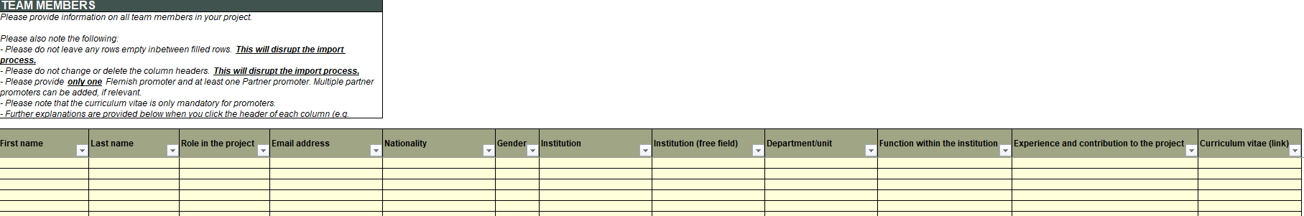
Module 3
Organisation : Annex 1
How do you want to do it?
Update the information about who is involved in the project in the Excel format. Apart from personnel details, information is requested on the experience and contribution (know-how, expertise, etc.) to the project. Preference: online links to CVs
Notes:
Next to the narrative description, you will be asked to select the relevant VLIR-UOS outcomes and domains to which your project aligns when submitting the proposal in the VLIR-UOS tool

Slide 38
Module 3
Organisation
Key questions
Who is involved and what are their roles / responsibilities?
How is the project structured / organised?
How will the tasks be divided among the involved partners (local – Flemish) in a balanced way?
Maximum 2.500 characters
Use Excel format for the organisation details related to question 1
Notes:
Describe the project’s organisational structure/governance, internal communication, and distribution of roles and responsibilities, with attention for balanced partnership structures and interinstitutional cooperation. In case multiple partners are involved at Flemish or partner level, the roles of each partner in the implementation and management of the project need to be explained

Slide 39
Module 3
Organisation
Selection criteria for candidate-participants
Examples
  Academic level (master, PhD, etc.)
  Domain(s) of previous education
  Professional expertise
Describe the procedure (incl. selection commission) to select (scholarship) candidates.
Targeted communication and recruitment policy
Focus on specific region or country or specific background (LNOB)
How will you target
  participants from the VLIR-UOS scholarship list
  male and female participants in a 60/40 ratio
Maximum 2.500 characters
Maximum 2.500 characters

Slide 40

Module 4
Stakeholders and coherence
1. Identification
2. Analysis
3. Strategies for stakeholder engagement & uptake
4. Coherence: internal & external
ESSENCE
Identify and analyse the project stakeholders and elaborate a strategy to manage the stakeholders throughout the project.

Slide 41
Module 4
Stakeholders management
What ?
General management of the interactions with the most important stakeholders of a project (external to the project team) contributing to the realization of the project outcomes and impact (e.g. the end-users of the project results)
Identify the project’s 3 most important stakeholders How manage / engage with them
  employers of the trainees e.g.
Approach
Maximum 3.000 characters

Slide 42
Module 4
Coherence
Coherence is about the complementarity of the project with the actions and networks of other actors and/or other HES4SD initiatives. Elaborate on any coherence with:
other VLIR-UOS funded activities (e.g; with TEAM/SI, IUC, Global Minds projects, ICP Connect,..) (internal coherence);
and with other actors/projects (e.g. local, partner country level, regional, Belgian non-governmental actors, etc.) (external coherence)
Please note that lessons learned from previous experiences from earlier projects and/or between the projects partners fit under Module 8.
Maximum 2.500 characters

Slide 43

Module 5
Planning and budgeting
1. Operational plan
2. Budget
ESSENCE
Focus on how the project will contribute to the set goals in the six project domains. It specifies what activities must be done to achieve a particular goal (or goals), when they need to be done and who is going to do them. Includes both the outputs that need to be delivered and the financial & human resources attached to it.
Notes:
Where, what, when, who?

Slide 44
Operational plan
In the operational plan, activities are to be organized according to the six standard VLIR-UOS project domains
Domain | Intermediate change
Research programmes and methods | Improved (interdisciplinary) methodologies and strengthened quality and relevance of research to allow for better knowledge management and high-quality research results serving societal needs
Education programmes and methods | Improved, innovative and inclusive teaching methods, didactics, and digital approaches. Improved curriculum content to support knowledge co-creation and equip students with the necessary skills and knowledge ensuring their employability after graduation and ability to tackle global challenges from a holistic, interdisciplinary perspective
Outreach and policy support | Enhanced interaction with relevant public, private and academic stakeholders to share knowledge, create the conditions for uptake and provide policy advice/support
Systems, policies, and infrastructure | Better management, information systems, educational and research policies to improve functioning of HE&SIs, including policies on gender and diversity, research integrity and uptake. Improved equipment, laboratories and offices for education and research
People | Students, alumni, staff, researchers are trained/sensitised in a supportive learning environment to strengthen their knowledge, skills & attitudes in diverse domains (e.g. leadership, global citizenship).
Networks and partnerships | Strengthened interactions within reciprocal partnerships and engagements at local, regional and global levels between HE&SIs, researchers, staff, students and other stakeholders in society (public actors, private actors, other civil society organisations (CSOs), communities, etc.) for sustainable development
Notes:
ITP projects will primarily focus on outcome (1), though may also include outcome (2) and (4) but this will be depending on the priorities and main objectives of each ITP, meaning that some might focus more on (1) and (2) while others focus more on (1) and (4), depending on priorities and needs of the stakeholders. Yet, projects are required to document their choices to ensure alignment with their own strategy. This strategy needs to resonate with the VLIR-UOS vision towards change (= the generic Theory of Change as set out in this document). Because in the long term, all ITP projects combined, should contribute to development changes (cfr. Sustainable and equitable development via the SDGs and Agenda 2030), resonating with the impact areas of the general theory of change of VLIR-UOS.
An ITP project can focus on different project domains (=domains of intermediate change) that contribute to the different outcomes, with ‘Education programme and methods’, ‘People’ and ‘Networks and partnerships’ being the main ones. It is possible that ITP projects focus on one or more of the other project domains (outreach and policy support; research programmes and methods; systems, policies and infrastructure) and if this is the case, promoters are invited to clarify their focus on one of these additional domains.

Slide 45
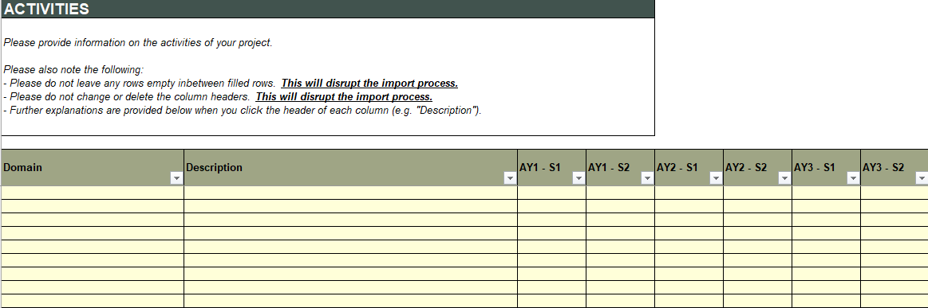
Activities : Annex 1

Slide 46
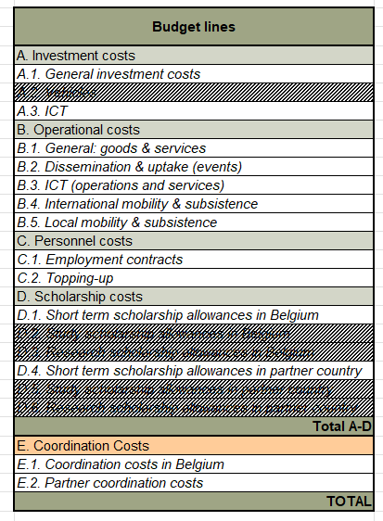
Budgetfile : Annex 2

Slide 47
Module 5
Budget: value for money
Motivate & elaborate how much will be spent on the different activities and why you choose this repartition + explain co-funding
Particular attention :
  any personnel costs,
  (b) investment costs or
  (c) scholarships that do not fall under the general scholarship guidelines
A minimum of 8 scholarships per training/edition needs to be provisioned
If relevant, identify what parts of the budget will be managed by which partner (Flemish/partner HEI(s)).
For the 10% coordination cost, clarify
  10% coordination cost in Belgium (10% lump sum) or
  5% coordination cost at the level of the Flemish institution + 5% at the level of the Partner institution (if relevant to be subdivided over different institutions).
Maximum 4.000 characters
Notes:
(e.g. for ITPs organised in partner countries, blended programmes, etc.) and for which a scholarship amount needs to be determined in the proposal.

Slide 48

Module 6
Risks
1. Identification
2. Assessment
3. Risk response and monitoring
NOT APPLICABLE FOR ITP PROJECTS

Slide 49

Module 7
Monitoring
Describe your approach in terms of monitoring & quality assurance
Selected projects will be asked to report on a limited set of generic, standard indicators
Describe how you would assess/monitor the results of your specific project (can be both qualitative or quantitative).
How would success look like, and how will you assess it?
Maximum 2.000 characters
Notes:
e.g. student satisfaction, extension/outreach/capacity-building activities realised, uptake/influence of new skills, cf. Next slide

Slide 50
Module 7
Monitoring
Level (%) of student satisfaction with quality and relevance of study programme / module
# of (non-academic) extension/outreach/capacity-building activities realised (presentations, trainings, sensitisation activities...) through the support of the project, targeting communities, governments, civil society or private sector actors
# of persons in communities, governments, civil society and/or private sector reached through (non-academic) extension/outreach activities realised (presentations, trainings, sensitisation activities...) through the support of the project targeting
Uptake/influence of new skills/knowledge in professional environment of trainees. Use the following scale (self-assessment): 1 - skills/knowledge has been transferred to trainees; 2 - some trainees are applying new skills/knowledge; 3 - most trainees are applying new skills/knowledge; 4 - trainees are successfully transferring skills/knowledge to their professional context; 5 - New skills/knowledge are being applied at scale in the professional environment of trainees

Slide 51
Module 7
Monitoring
# and type of newly established strategic partnerships / collaborations directed at improved education, research and uptake with relevant external stakeholders as a result of the project
# scholarships made available to students in VLIR-UOS supported programmes by external actors (industry / government agencies / NGOs / international agencies)
# of newly established or strengthened networks (incl. subject-related thematic / alumni / regional networks) by the project in which the staff and students of the supported higher education institutions actively participate
# of participants from non-developing countries
# of participants from developing countries other than those from the VLIR-UOS country list
# of participants from developing countries from the VLIR-UOS country list (not holding a VLIR-UOS scholarship; e.g. self-supported or other scholarship)

Slide 52

Module 8
Learning & steering
1. Lessons learned
2. Follow-up & steering
ESSENCE
Describe how to follow-up on changes, adaptations and lessons learned from (previous) experiences in order to improve the quality of the project.

Slide 53
Module 8
Learning & steering
Key questions
1) Project track record:
  New
  Follow-up project: Continuation of an existing intervention or finalisation/harvesting phase
  Re-submission
(A checkbox will be included in the online submission tool)
2) List, if relevant, previous experiences, projects between the project partners and describe the achievements / actions already undertaken.
  Lessons learned from previous experiences be taken on board
  In case of follow-up projects: added value
  Re-submission: indicate how you dealt with shortcomings as compared to a previous proposal
Maximum 2.500 characters
Notes:
Note: If this is a first-time project, the question below can be left open.

Slide 54
Annexes
    Annex 1: Excel sheet with tabs per module for formulation
    Annex 2: ITP budget format
    Mandatory Annexes without format
    Annex 3: CVs of the promoters (if no online link)
    Optional Annexes
    Endorsement letter of the partner institution(s)
    Letter of support of formalised Synergy / Multi-Stakeholder Partnership (MSP)/etc.
    CVs of Co-promoters (not mandatory, if no online link)
General information | General information on the project
Module 3 | Information on who is involved in the project and its organisational structure
Module 5 | Activities (= activity plan, organised per intermediate change domain)
Notes:
Endorsement letter: institutional support letter, referring to the employment link of the main partner promoter with a (recognized higher education) partner institution, and the support of this same institution to the project. The letter should be signed at least by an authority at Faculty level.

Slide 55

Questions, remarks, reflections ?
Thank you!

